Slide 1
Farm To Home
Erick James Ms. Lisha Varghese
INTMCA S9 Asst. Professor
Amal Jyothi College of Engineering Amal Jyothi College of Engineering

Slide 2
Content
Project Overview
Existing System and Limitations
Key Features
Diagrams
System Architecture
Visual Representations

Slide 3
Project Overview
Platform Purpose: Farm to Home is a Django-based e-commerce platform.
Product Range: Farmers can sell fresh produce, dairy, meat, and specialty foods.
Focus on Sustainability: Emphasizes sustainable practices by promoting local sourcing.
Environmental Benefit: Aims to reduce "food miles," minimizing transportation-related emissions.
Consumer Benefits: Provides consumers access to fresh, seasonal products.
Community Engagement: Encourages community interaction via forums, programs, and local events.

Slide 4
Project Modules
The modules in the system are:
•Consumers
•Admin
•Farmers

Slide 5
Existing System
Local farmers mostly depend on traditional channels like farmers’ markets, small stores, and word-of mouth to connect with consumers, which limits their reach, convenience, and efficiency.
consumers face challenges finding fresh, locally sourced foods on conventional online platforms, which often prioritize large retailers.
Additionally, these platforms rarely include information on sustainability, farming practices, or community engagement—elements that many consumers value when purchasing local products.

Slide 6
Existing System
Limitations
•Limited Reach for Farmers: Farmers have limited access to a broader consumer base,which restricts their potential market and impacts their profitability.
•Lack of Convenience for Consumers: Consumers cannot consistently access local products or verify the sustainability and quality of the items.
•Lack of Direct Interaction: Current models do not provide consumers and farmers with direct communication channels, limiting transparency around sourcing, farming practices, and community initiatives.
•Environmental Impact: Traditional e-commerce models contribute to increased food miles and carbon footprint as most products are sourced from distant locations.

Slide 7
Key Features
Consumers:
•User Authentication and Profiles: Secure registration and login for farmers, consumers, and businesses. User profiles with preferences for product types, delivery options, and farming interests.
•Payment management
•Browse and filter local products and purchase fresh, seasonal foods.
•enjoy convenient delivery or pickup options.
•Engage with the local agriculture community through forums and events.
Farmers:
•Profiles for farmers and food producers showcasing their products, farming practices, and sustainability certifications.
•List and sell products directly to local consumers.
•Manage inventory, pricing, and product descriptions.
•Access marketing tools and analytics to optimize sales and customer relationships.
•Information on farm locations, crop rotations, organic practices, and community involvement.

Slide 8
Key Features
Administrators:
•Manage platform operations, farmer partnerships, and product listings.
•Ensure compliance with food safety standards, sustainability guidelines, and local regulations.
•Monitor platform performance, user engagement, and market trends to enhance platform functionality and user experience.
•Analytics and reporting features to track sales, inventory levels, and customer satisfaction.

Slide 9
System Architecture
Backend: Django Framework (Python)
Frontend: HTML5, CSS3, JavaScript
Database: SQlite
Hosting: Cloud-based platforms
Payment Integration: Razorpay

Slide 10
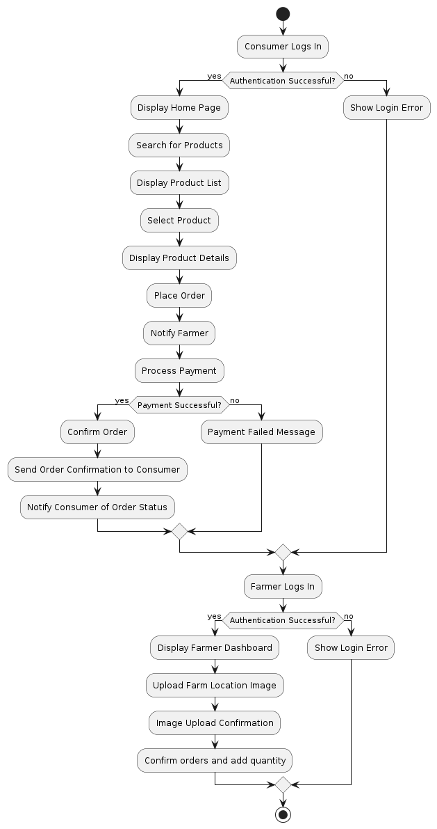
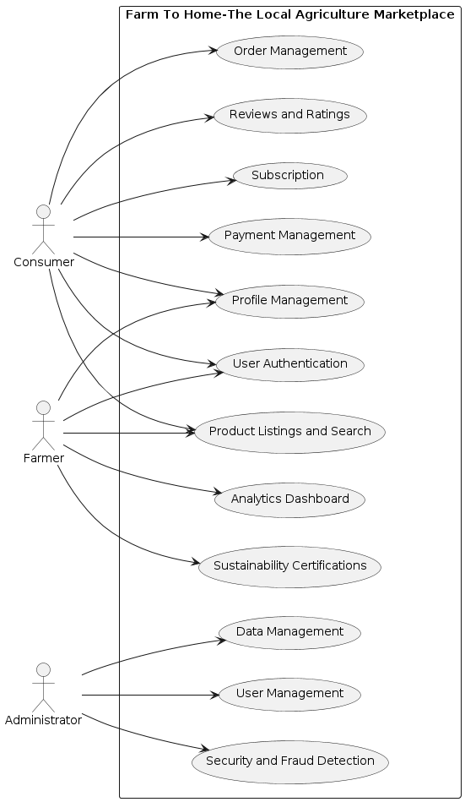
Diagrams
Activity Diagram
Use Case Diagram

Slide 11
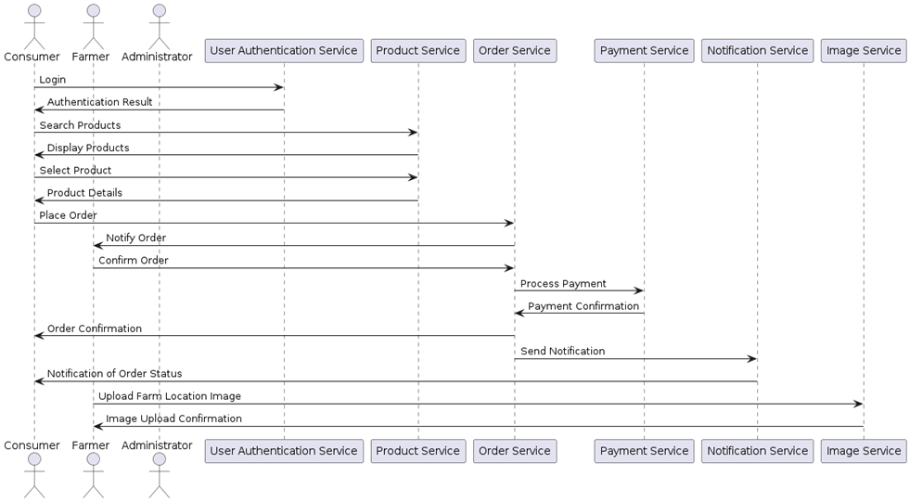
Diagrams
Sequence Diagram

Slide 12
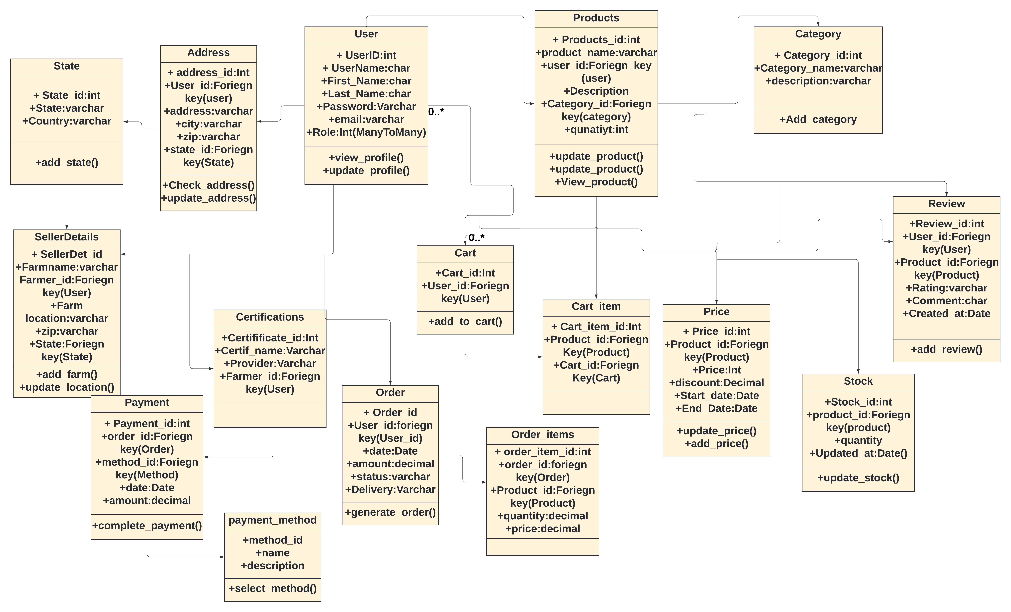
Diagrams
Class Diagram

Slide 13
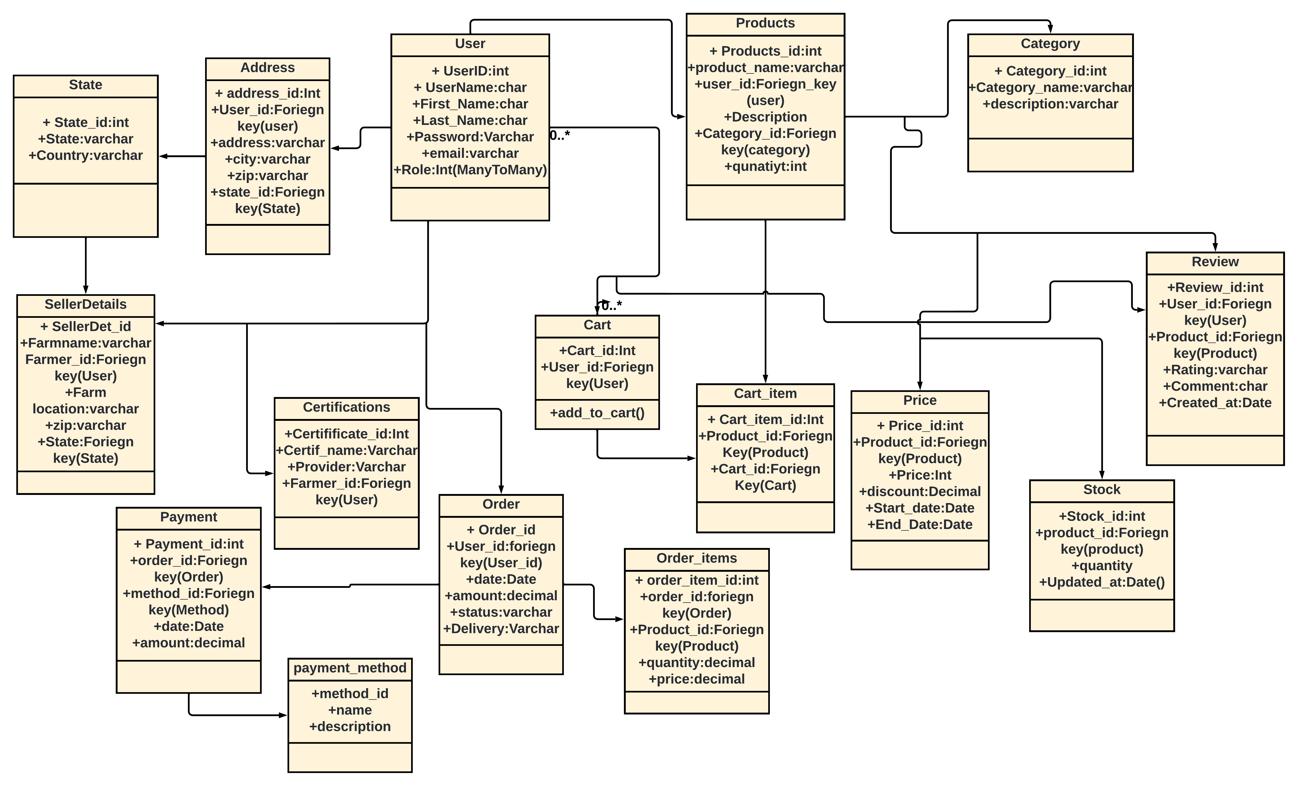
Diagrams
Object Diagram

Slide 14

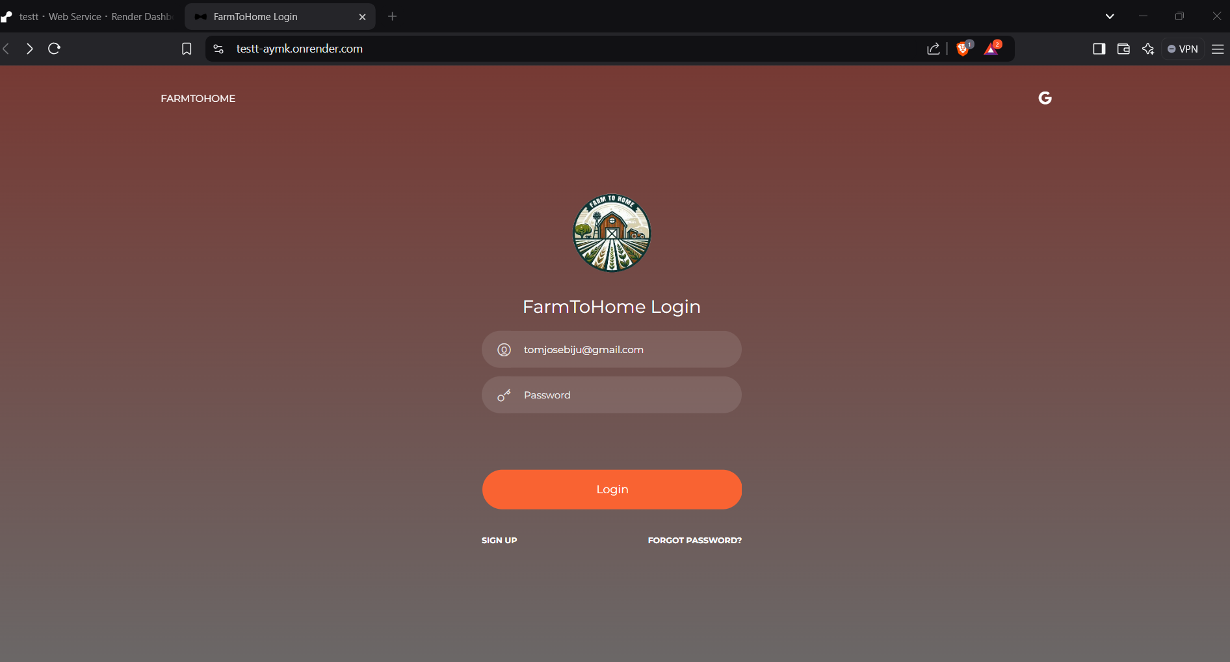
Registration and Login Pages

Slide 15
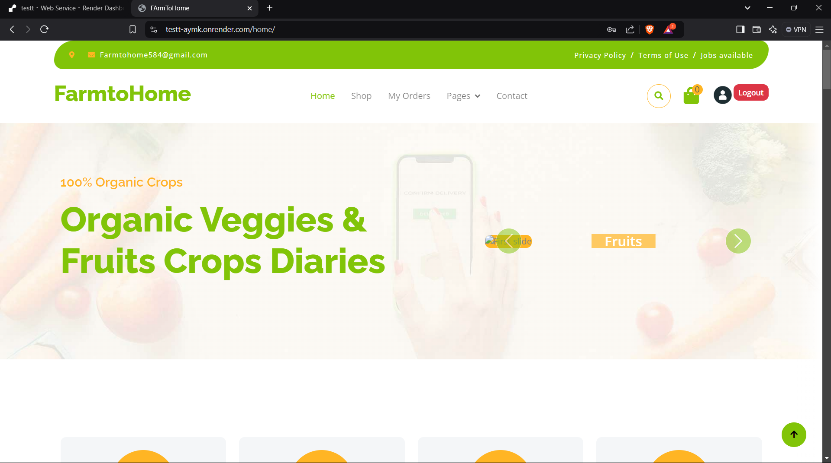
User Index Page Pages

Slide 16
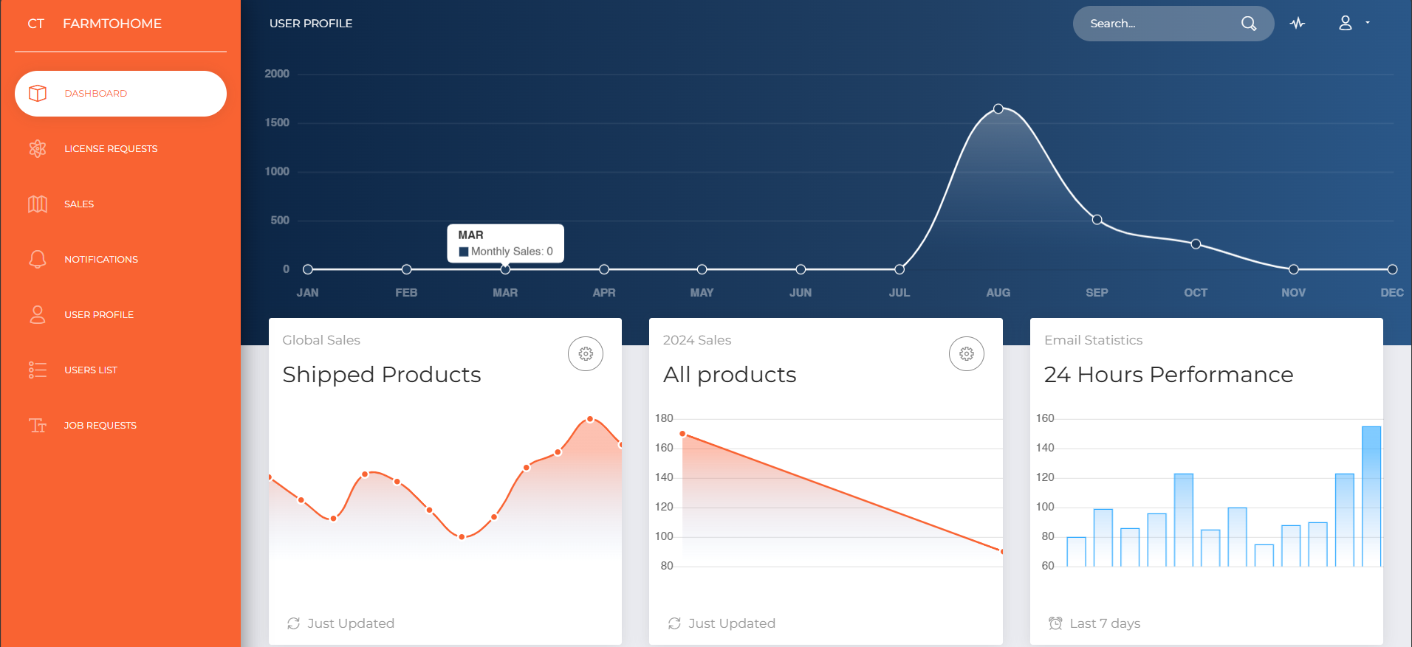
Admin Index Page Pages

Slide 17
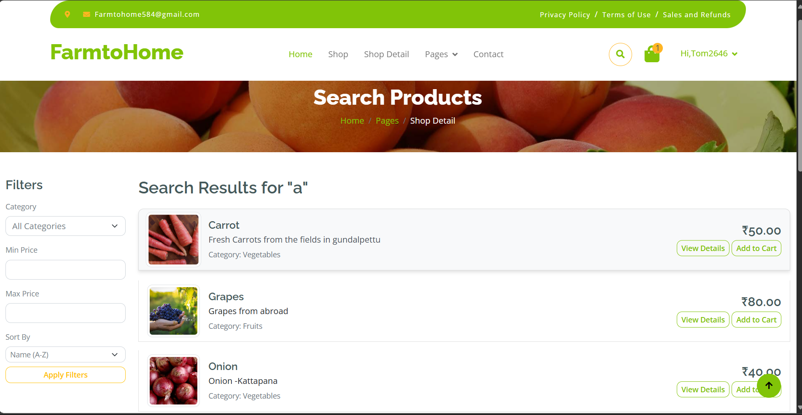
Search Result Page

Slide 18
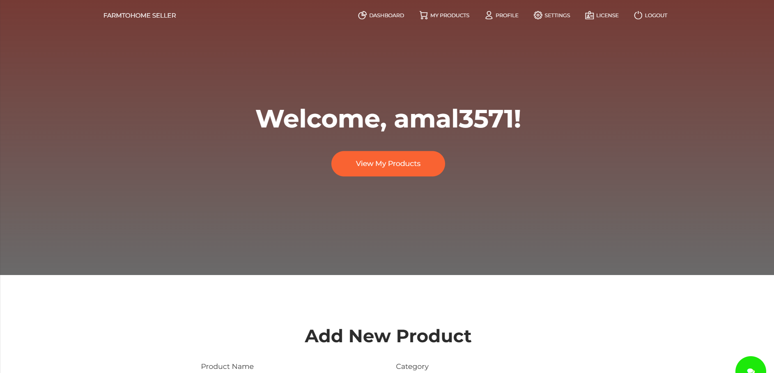
Seller Product add Page

Slide 19
Thank you
Erick James
S9
AJC20MCA-I032

